Slide 1

MINI PROJECT
(Time Table Generator)
A.Y – 2024
BY
1) Samiksha Patil – 22106041
2) Nikita Patil – 22106081
3) Rohan Patil – 22106044
4) Jay Wadnere – 22106105
Under the Guidence of : Prof.Viki Patil

Slide 2

TIME TABLE GENERATOR
USING DJANGO FRAMEWORK

Slide 3
INDEX
Introduction
01
Literature Survey
02
Limitations of existing system
03
Problem statement
04
System Design
05
06
Technologies/Methodologies
Implementation
07
08
Conclusion
References
09

Slide 4
01
INTRODUCTION
This helps save time and resources while ensuring a balanced and feasible schedule.
The project features a clean and user-friendly interface.
Which generates time table automatically and avoids complexicity of setting and managing.
Time table generator is defined as an desktop application.

Slide 5
Managing subjects, lectures, and classrooms in universities and learning institutions is complex and time consuming. Creating educational timetables manually is arduous and leads to scheduling clashes. To address these issues, an open-source solution using AngularJS, Bootstrap 3, and PHP was developed, providing a cost effective and flexible alternative to commercial application [5]. During the COVID-19 pandemic, students struggled with time management. A research paper introduces a greedy algorithm to enhance semester planners, improving student productivity. It validates data and optimizes task sequences efficiently, with testing showing its effectiveness compared to the Brute Force algorithm [1]. Timetable generation is a common challenge for colleges. A paper outlines an application that utilizes genetic algorithms to allocate subjects to staff and classes for students, streamlining the process and addressing scheduling conflicts [4]. Automated timetable generation addresses the challenges of manual systems in colleges. It leverages constraints and constraint programming to create dispute-free timetables efficiently, catering to various variables, such as lectures, subjects, and faculty [3]. For universities with multiple branches and batches, creating timetables is time-consuming. An algorithmic approach is introduced to save time and reduce the manual burden.
02
LITERATURE SURVEY

Slide 6
03
LIMITATIONS OF EXISTING SYSTEM
Time table generators may have limitations such as :
difficulty handling complex constraints, inability to adapt to sudden changes, and challenges in accommodating preferences for specific time slots or instructors.
Additionally, they might struggle with optimizing for various factors simultaneously, leading to less-than-ideal schedules.
The potential for inefficiency in handling large datasets, leading to longer processing times, and difficulty in addressing unforeseen events like sudden faculty unavailability or unexpected resource constraints.
Additionally, user interface limitations may impact the ease of use for individuals with varying levels of technical proficiency.

Slide 7
04
PROBLEM STATEMENT
Problem Statement :
Creating a timetable manually can be a time consuming and error-prone task, especially in educational institutions or workplaces with complex scheduling requirements.
The need for an automated Time Table Generator arises to efficiently allocate resources, such as rooms, faculty, and time slots, while adhering to various constraints and preferences.
Solution:
Develop a Time Table Generator application that takes into account the following aspects:
Input Parameters: Number of days in the week. Available time slots for classes.
List of subjects and their respective durations. Faculty availability and preferences. Room availability and capacities.
Constraints: Avoid clashes in faculty schedules.
Ensure room capacity matches the class size.
User Interface: Create a user-friendly interface to input data and visualize generated timetables. Allow users to make adjustments or manually intervene if necessary.

Slide 8
SYSTEM DESIGN
05
LOGIN PAGE
For student
For staff
REGISTRATION PAGE
HOME PAGE
STAFF PAGE
For admin
ADMIN PAGE
View time table
Calender
Logout
Generate time table
Staff Allocations
View timetable
View staff details
Logout
Username
Email ID
Password

Slide 9
BLOCK DIAGRAM
Admin Page
Start
Admin login
Exit
Home Page
Start
View timetable
Calender
Logout
Exit
Staff Page
Generate timetable
Staff Allocation
View timetable
View staff details
Start
Logout
Exit

Slide 10
06
TOOLS / SOFTWARE USED
Frontend / Backend –
Python
Html
CSS
JavaScript
Vs code compiler
Django
SQlite

Slide 11
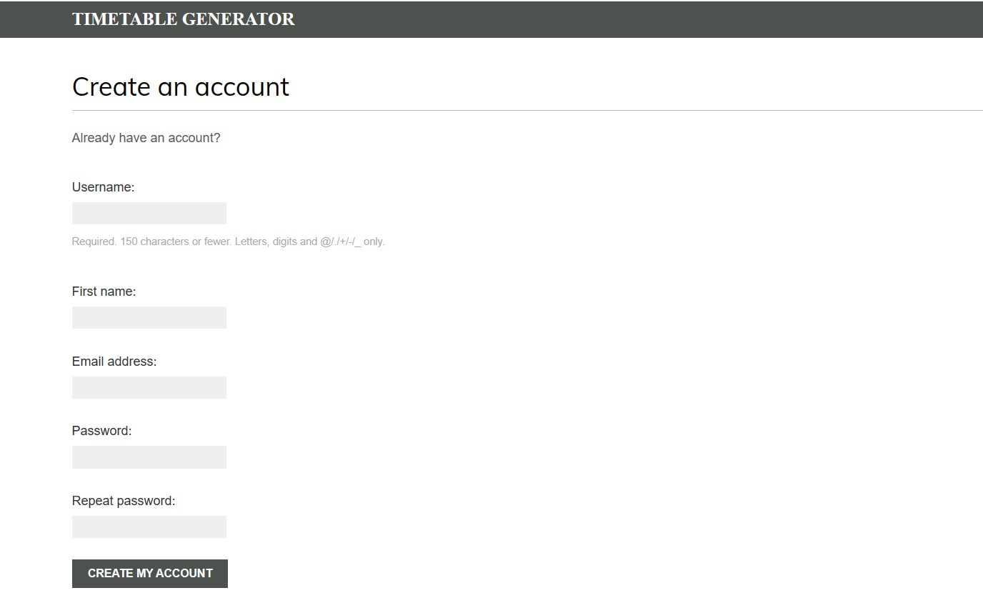
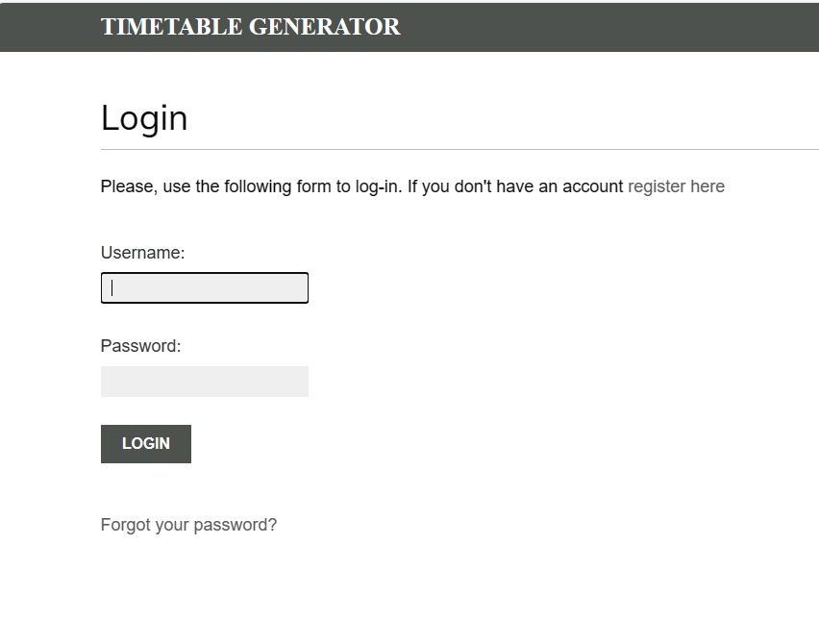
IMPLEMENTATION
07
1. Registration page 2. Login page
1.222

Slide 12
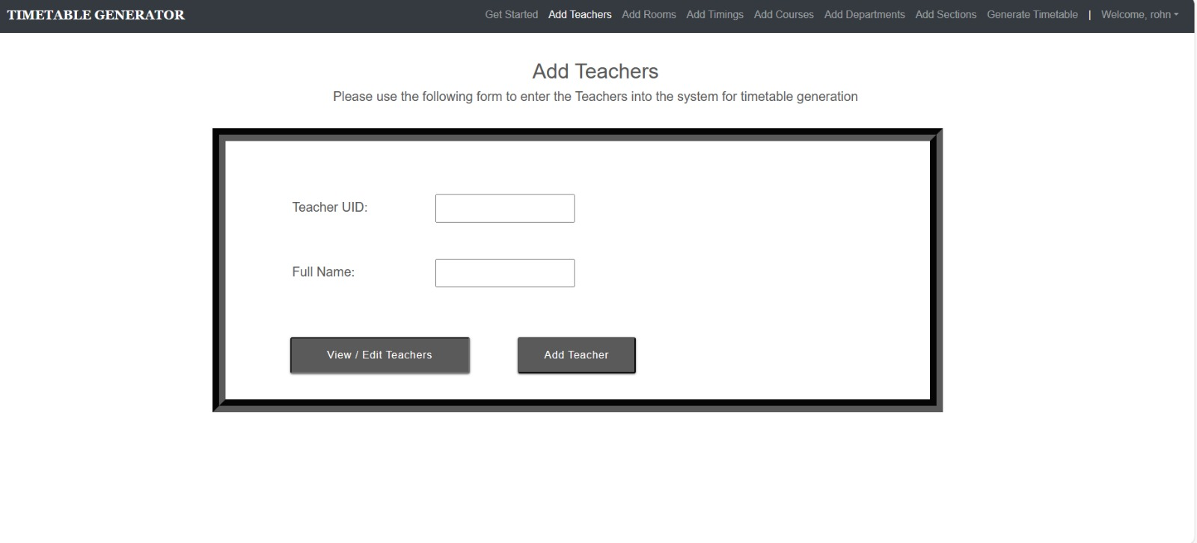
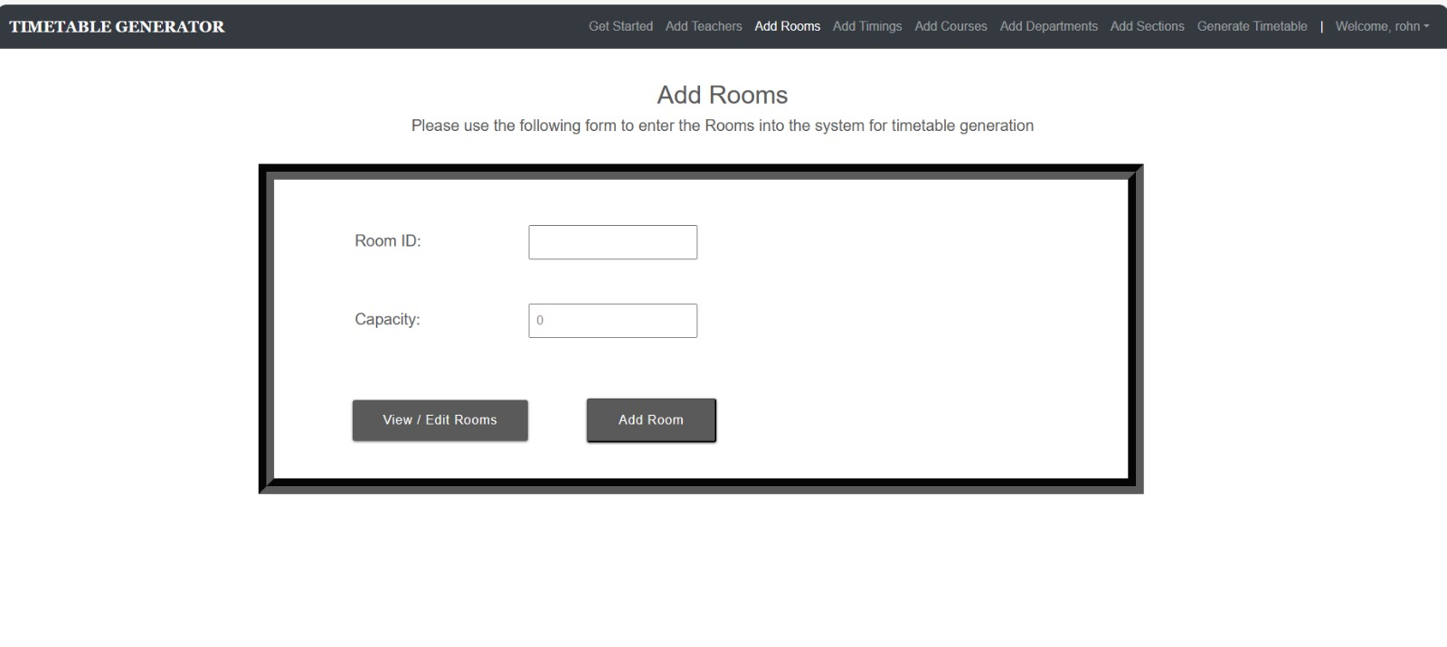
3. Staff page

Slide 13
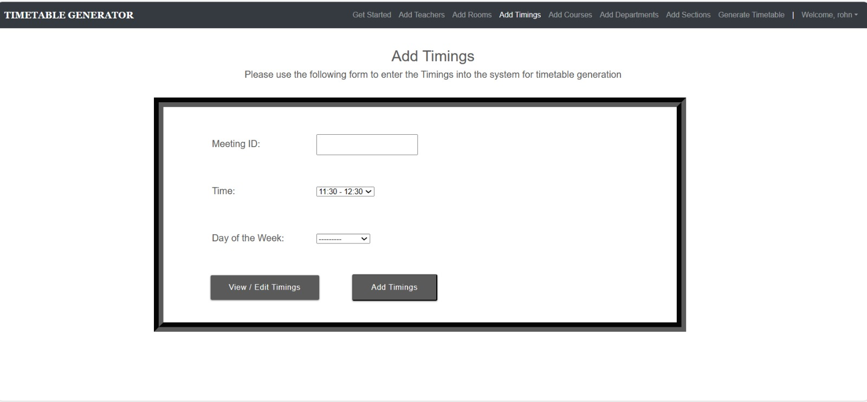
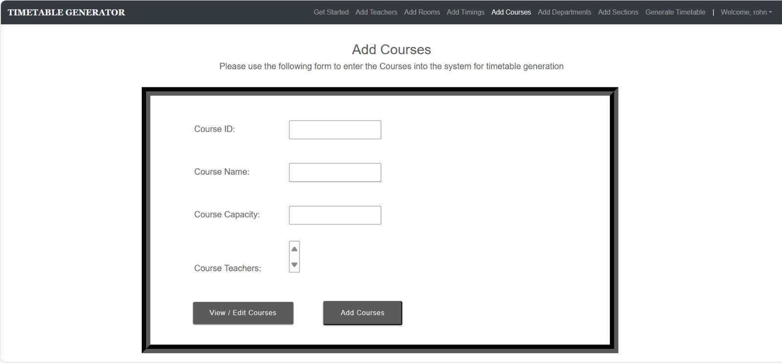

Slide 14
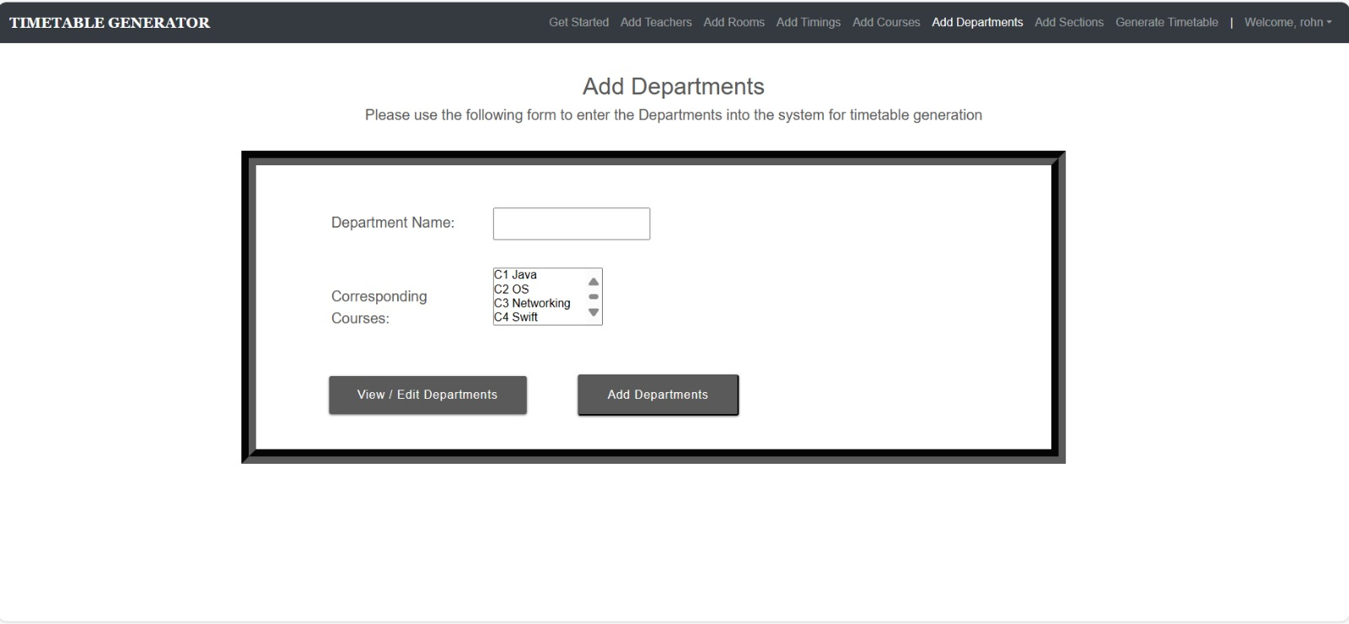

Slide 15
08
CONCLUSION
Our approach of developing automated timetable system ,We have also shown that how we can fit our time tabling system as Rich Desktop Application.
The Graphical user interface (Windows Form Application) used in this application provides an easy way in understanding how application works and also make ease in providing the input.
The project reduces time consumption and pain in framing the timetable manually.
As compared to manual generation it involves in satisfying all the constraints -
No overlapping of time slots for any subject.
No repetition of time slots per faculty.

Slide 16
09
REFERENCES
[1] Khyrina Airin Fariza Abu Samah, Siti Qamalia Thusree, Ahmad Firdaus Ahmad Fadzil, Lala SeptemRiza, Shafaf Ibrahim, Noraini Hasan, “A Greedy-based Algorithm in Optimizing Student’s Recommended Timetable Generator with Semester Planner”, (IJACSA) International Journal of Advanced Computer Science and Applications, Vol. 13, No. 1, 2022.
[2] Ghrushneshwari Dattatray Mhaise, Chetana Sudhakar Kurhade, Mayuri Yadav Devre, Payal Sonawane, Tambe Balasaheb Parasram, “AUTOMATIC TIME TABLE GENERATOR”, International ResearchJournal of Modernization in Engineering Technology and Science, 04/April-2023.
[3] S.P.Ramesh, Anuj Gangwar, Ketan Singh, Anookarsh Ayan, “Automatic Timetable Generator”,Annals of R.S.C.B., ISSN:1583-6258, Vol.25, Issue 4, 2021.
[4] Abulaziz Aminu, wahyu Caesarendra, Umar S Haruna, Abubakar Sani, Mansur Sa’id, Daniel SPamungkas, Sumantri R Kurniawan, Endang Kurniawan, “Design and Implementation of An Automatic Examination Timetable Generation and Invigilation Scheduling System Using Genetic Algorithm”, 2019 IEEE .
[5] Mrunmayee V. Rane, Vikram M. Apte, Vishakha N. Nerkar, Mani Roja Edinburgh, K.Y. Rajput,“Automated Timetabling System for University Course”, 2021 IEEE.

Slide 17
THANK YOUU !!!

